Slide 1

Introduction to Software Development
Week 3 Day 2
Led by: Emily Crose
for
Oakland University

Slide 2

Last Session Review

Slide 3

Questions From Last Session?

Slide 4
Terms to listen for
Interface/UI
Visual elements of our application
Topology
Network architecture diagram
UX (User Experience)
Functionality of the app and its features
Root Cause Analysis (RCA)
An evaluation of the reasons behind a critical failure

Slide 5

The Software Development Life Cycle Continued

Slide 6
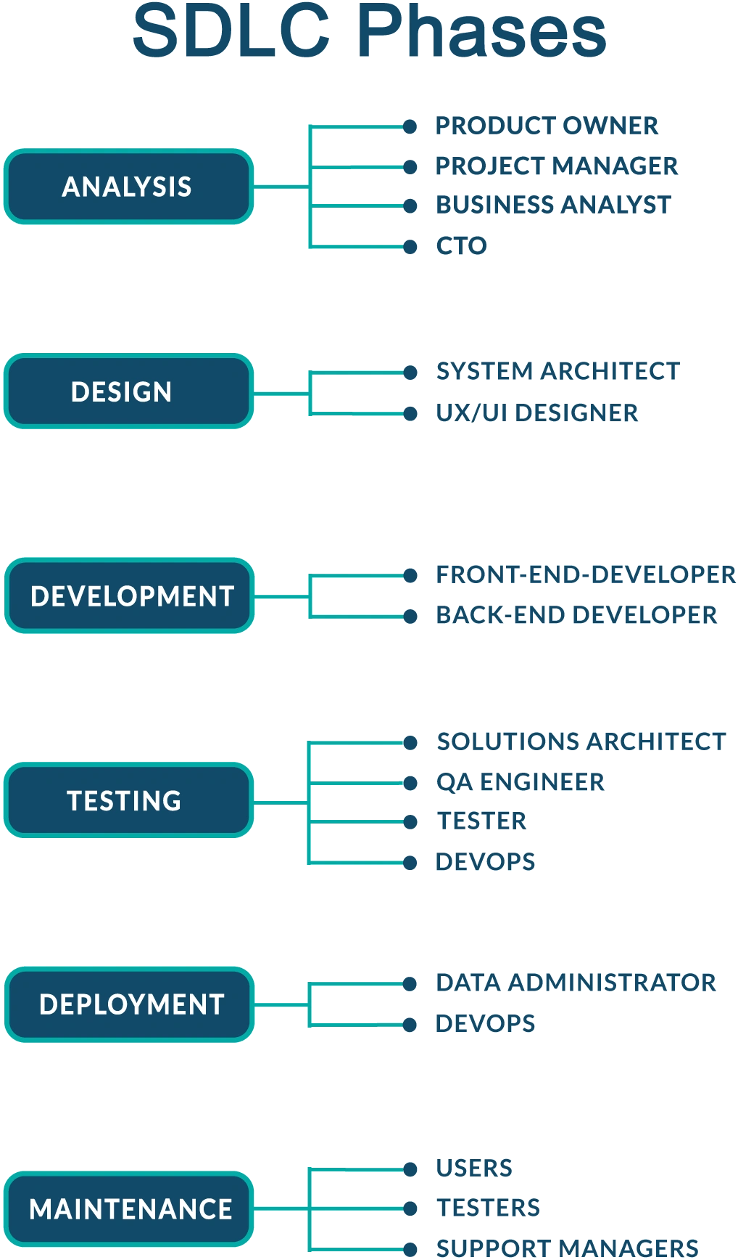
Notes:
If you’re taking notes, you’ll notice that this slide diverges from the last presentation of the SDLC. This isn’t a serious issue for us though, what we want to take away from the information we see here is the jist of planning, development, feedback, and beginning the cycle anew.

Slide 7

We’ve decided to make some software!
(Now what?)
Notes:
Yesterday, we talked about the importance of deciding whether or not we even need to build a piece of software. Well today, we’re going to deal with the post-facto decision to make software.

Slide 8

Design stage

Slide 9
Design roles
System architect
UX Designer
UI Designer

Slide 10
Design activities
UX mockups
Database requirements
prototyping
Notes:
So these are the activities we will expect to be working with when we go to design our product.

Slide 11

Visuals

Slide 12
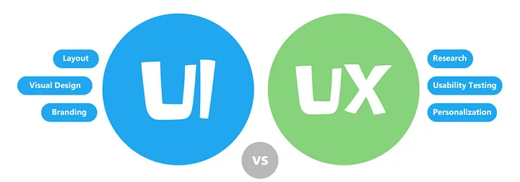
UI & UX
Notes:
You’re not just building an app, you’re building a relationship with your users.

Slide 13
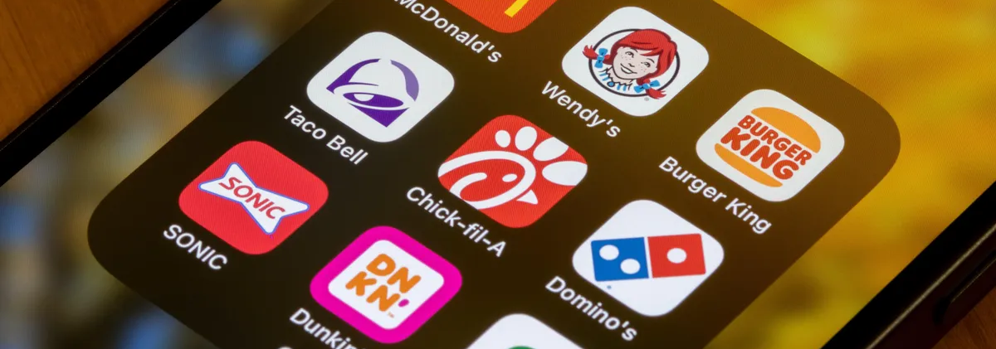
Branding

Slide 14
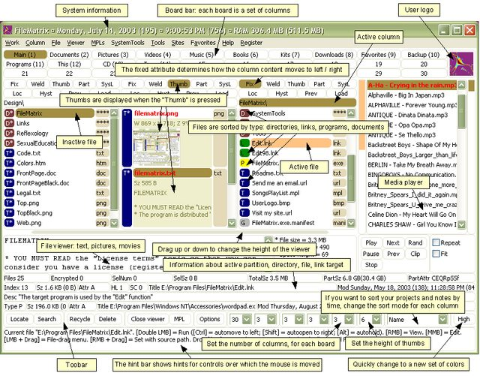
Cursed UI
Notes:
As far as we can tell, this hasn’t had any UI or UX work done. No layout, no personalization, no visual design makes us believe that there was no testing done of any kind. Thank god there’s no branding because this would be brand reputation damage.

Slide 15
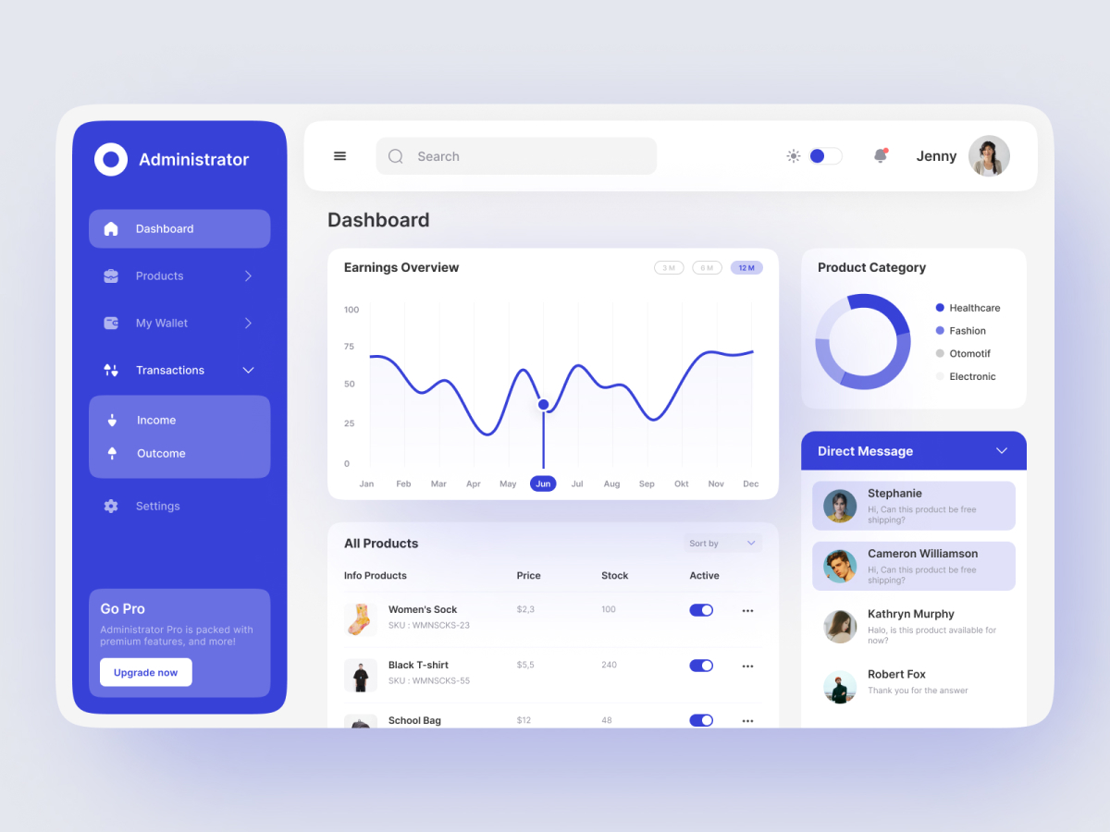
Minimalist UI

Slide 16
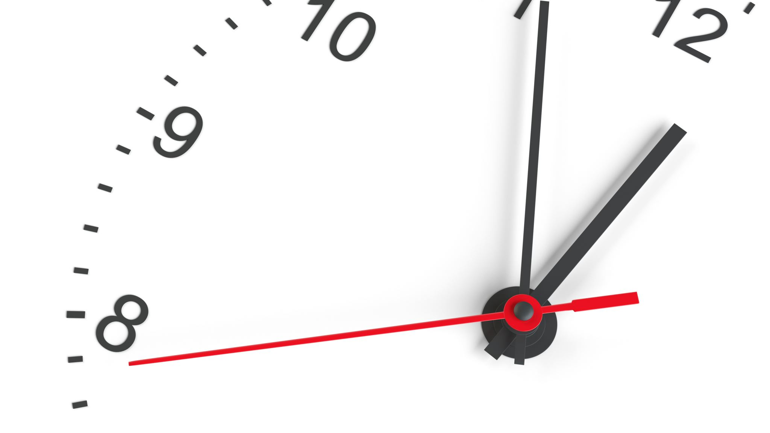
10 minute break

Slide 17

dependencies

Slide 18
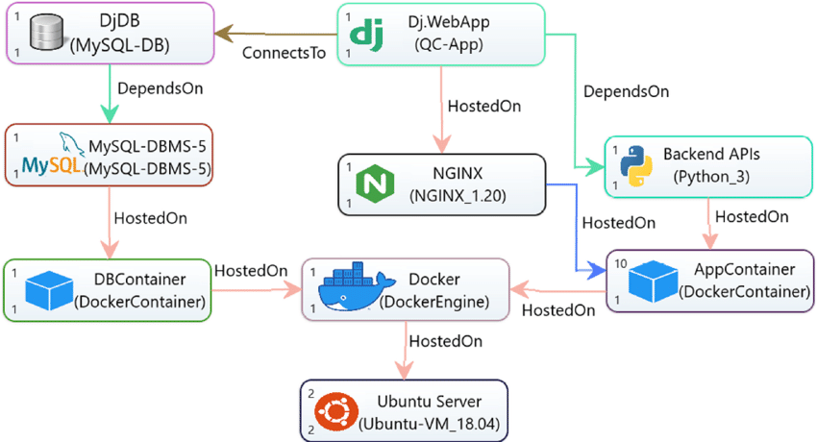
Dependency Diagram

Slide 19

Development Stage

Slide 20
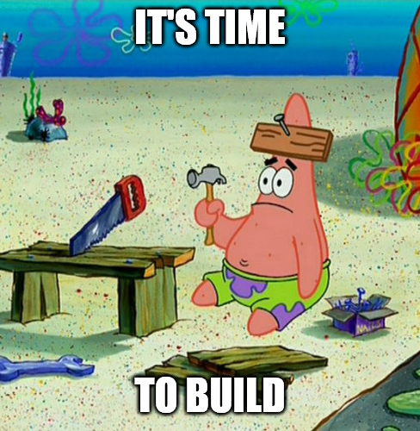
Develop phase activities

Slide 21

Development phase activities cont’
Building information sources
Back-end databases
Build feeds for ongoing information transfer
Building information consumers
Fed components of app

Slide 22

Consideration: Push, or pull?
Notes:
One consideration that we will likely make at some point in the design phase is to figure out whether the information our app consumes will be push-based or pull-based.

Slide 23
Developer Roles
Front-End Developer
Back-End Developer

Slide 24

Front-end developers
Deal with UI/UX problem solving
Work with visual programming languages
Design integration modules to attach to back-end information sources

Slide 25

Back-End Developers
Work with data distribution
Database administrators
System Engineers
Availability is key!
Are data Scientists needed?

Slide 26

Testing Phase
The most important stage?

Slide 27
Testing Roles
Solutions Architect
Quality Assurance Engineer
Software Tester
DEVOPS

Slide 28
Quality Assurance
Validates that specs are being met according to requirements put forth
Can conduct “Root Cause Analysis” when something goes wrong

Slide 29
Security Testing
Penetration Testing
Dependency analysis
Software Bill of Materials (SBOM)
Static code analysis
Fuzzing

Slide 30
Fuzz Testing
Randomized Input testing

Slide 31

Application Lifecycle Management (ALM)
Notes:
Application Lifecycle Management systems automate testing which includes software composition analysis tools, static code analysis and fuzz testing.

Slide 32
10 minute break

Slide 33
What Is Devops??

Slide 34
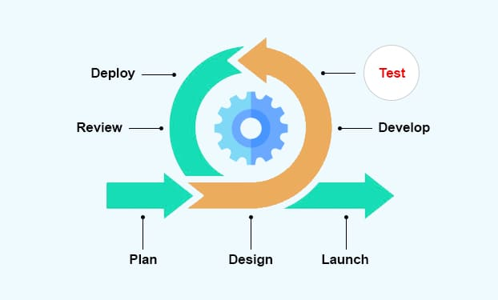
A different way to look at the SDLC

Slide 35
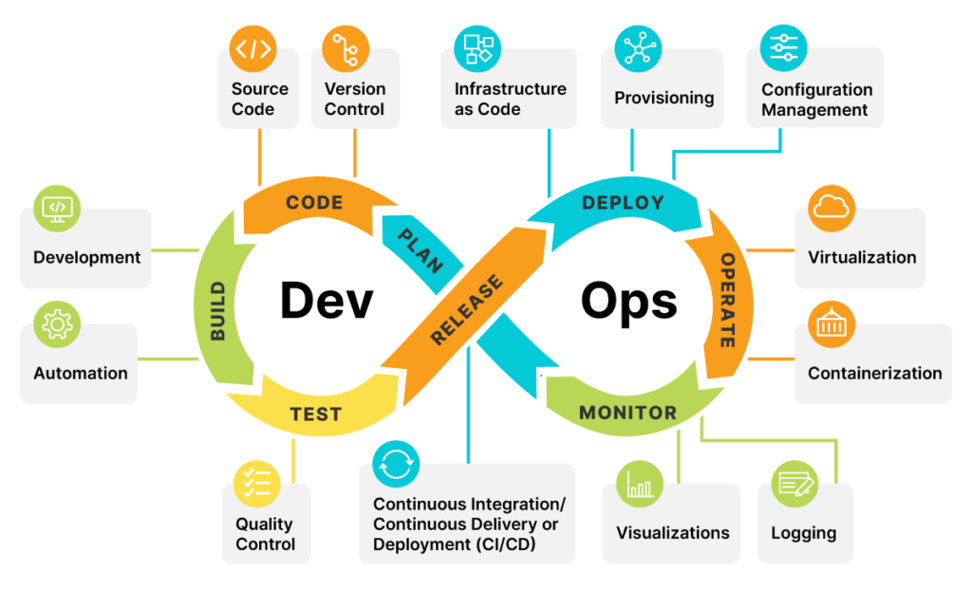
Notes:
DEVOPS is essentially the ongoing process of development with operations in mind. We run through a constant circuit of building, improving, testing, and releasing. Using a DEVOPS approach to the SDLC will help keep all of our efforts coherent.

Slide 36
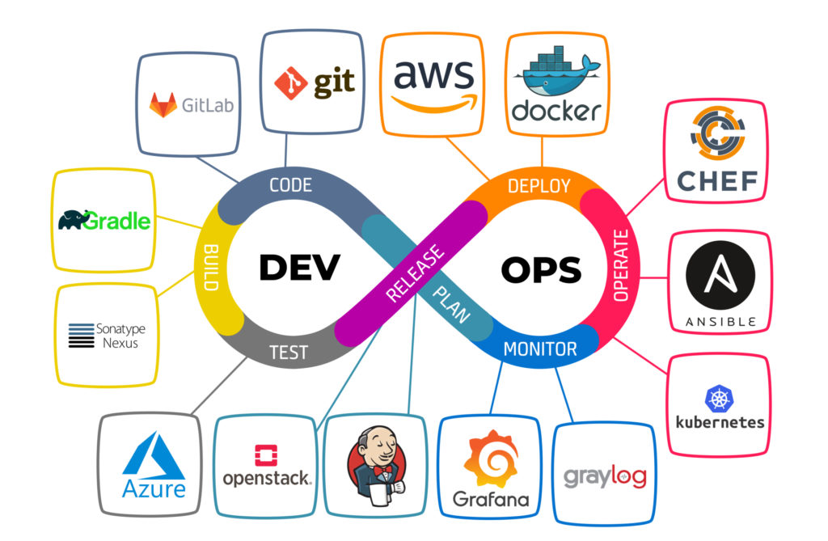
Notes:
Here’s a sampling of services we might use in each step of the devops cycle. Some of these you may be familiar with, others may be new to you. These are only tools though, they won’t do the entire process for you.
Ultimately, Devops can be very costly in terms of resources because there is a continuous need for high-fidelity communications. Not just between all of the development teams, but also between our own company and our clients.

Slide 37
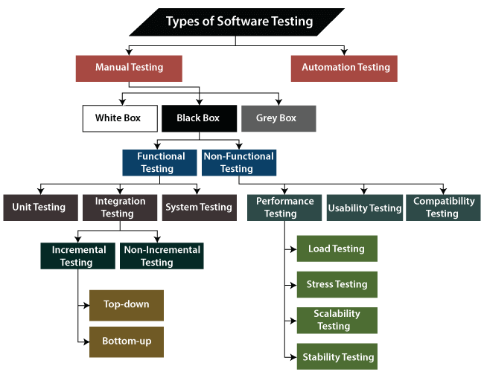
Testing Stage Activities

Slide 38
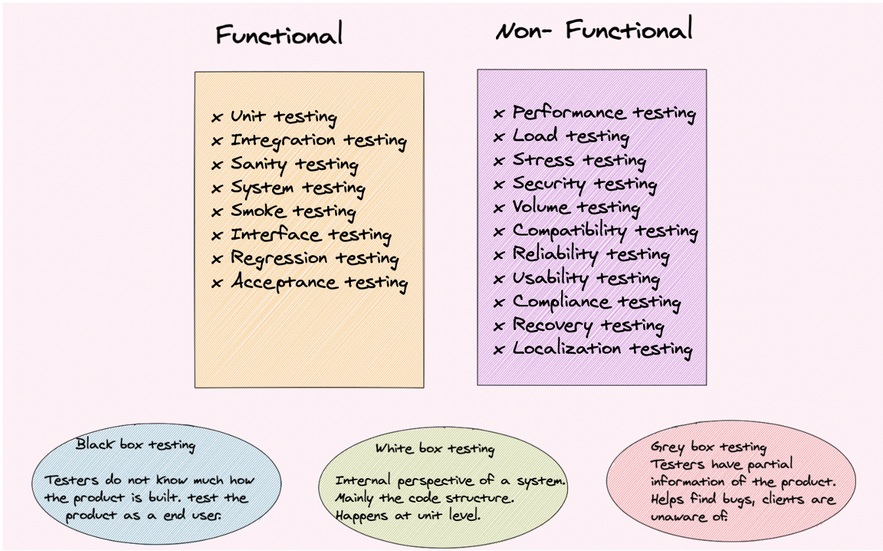
Functional vs non-functional Testing

Slide 39
Why is testing so important?
Pre-release
Easy to fix problems found
Discovery of missing pieces
Review assumptions
Notes:
Testing might be the most important phase to focus on because it’s pre-release. This is the first, best opportunity we have to verify that what we’ve been working on actually works the way it’s supposed to. We know that there might still be issues when it goes out, but at this point, we can easily fix the issues we have and re-release it if we need to.

Slide 40

Outcomes
Notes:
In terms of outcomes, we want to see fully tested code.

Slide 41
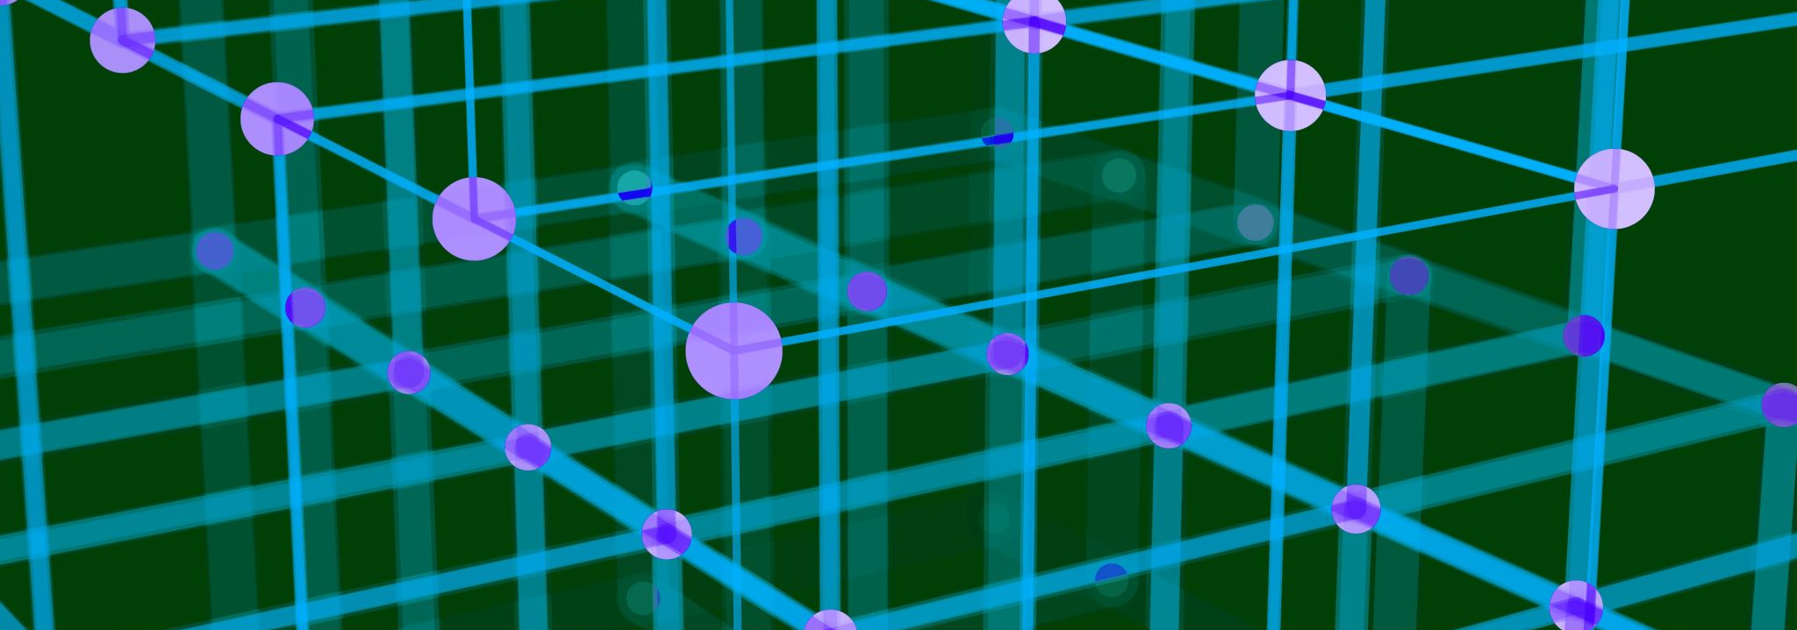
Deployment Phase

Slide 42

Deployment questions
How will our users get this app?
App store?
Direct download/sideloading?
How will users get future updates?

Slide 43

Deployment Roles
Data Administrator
Devops

Slide 44
Deployment activities
Final testing steps
Initial documentation phase
Making Software package available to customers
Customization and development testing
Installation to staging servers

Slide 45

Documentation documentation documentation
Notes:
I can’t stress this enough. We NEED to document all of the features of our product. This isn’t a question of maybe. Documentation is a part of the process, and we need to be as careful with the documentation that we right as we are with any other stage of development.
This documentation should be written so that it’s easy enough for our users to understand, and it also needs to be made available to them outside of our own internal documentation centers. We may maintain an internal document that holds back select proprietary information, but we should be judicious about the sorts of details we leave out. Remember that this information may come in handy one day if we ever lose a developer.

Slide 46
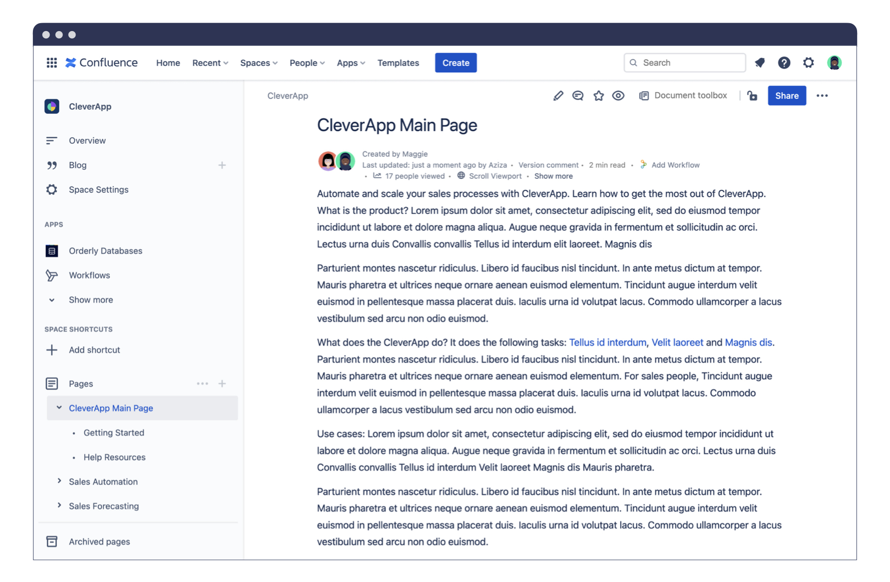
Tool: Confluence

Slide 47

User acceptance testing
Notes:
We may also do some user acceptance testing in the deployment phase. This is another way of saying alpha, or beta testing.

Slide 48

Maintenance Phase

Slide 49
Maintenance Roles
Users
Testers
Support managers
Field Support Engineers

Slide 50
Maintenance Activities
Break/fix
Product support
Demonstration/Field support

Slide 51

Communication
Notes:
A note on communication, we need to maintain ongoing communication between our development teams and our support teams. The only way we will know when we have an issue that needs to be resolved is when we get feedback through one of these “front door” channels.

Slide 52

Where are our “front doors”?
Notes:
We need to figure out exactly where our front doors are. Are they solely with our support organization? What about our sales and product teams? Do we have a built-in feedback form? These should be enumerated and kept track of.

Slide 53

Then what?
Notes:
And once we finish our SDLC, we start all over again!

Slide 54

Session Review

Slide 55

Question or clarifications?

Slide 56

Next Session Preview

Slide 57

See you next time!

